Slide 1

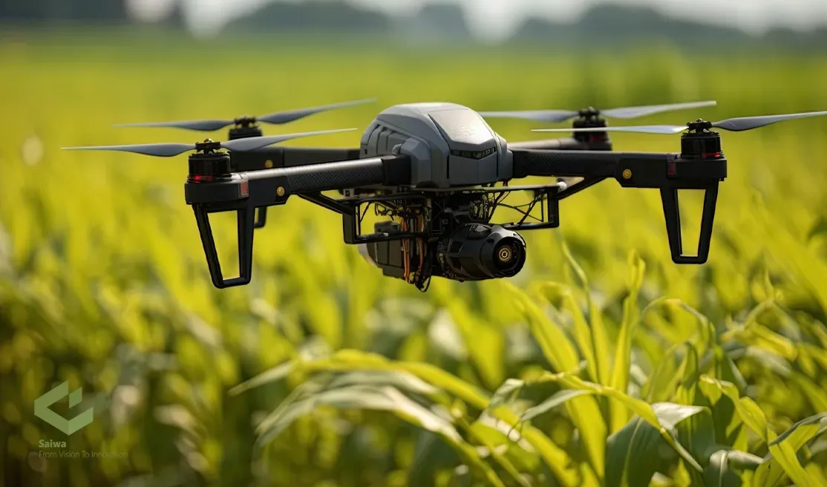
Drone-to-Drone Collaboration for Agricultural Surveillance

Slide 2
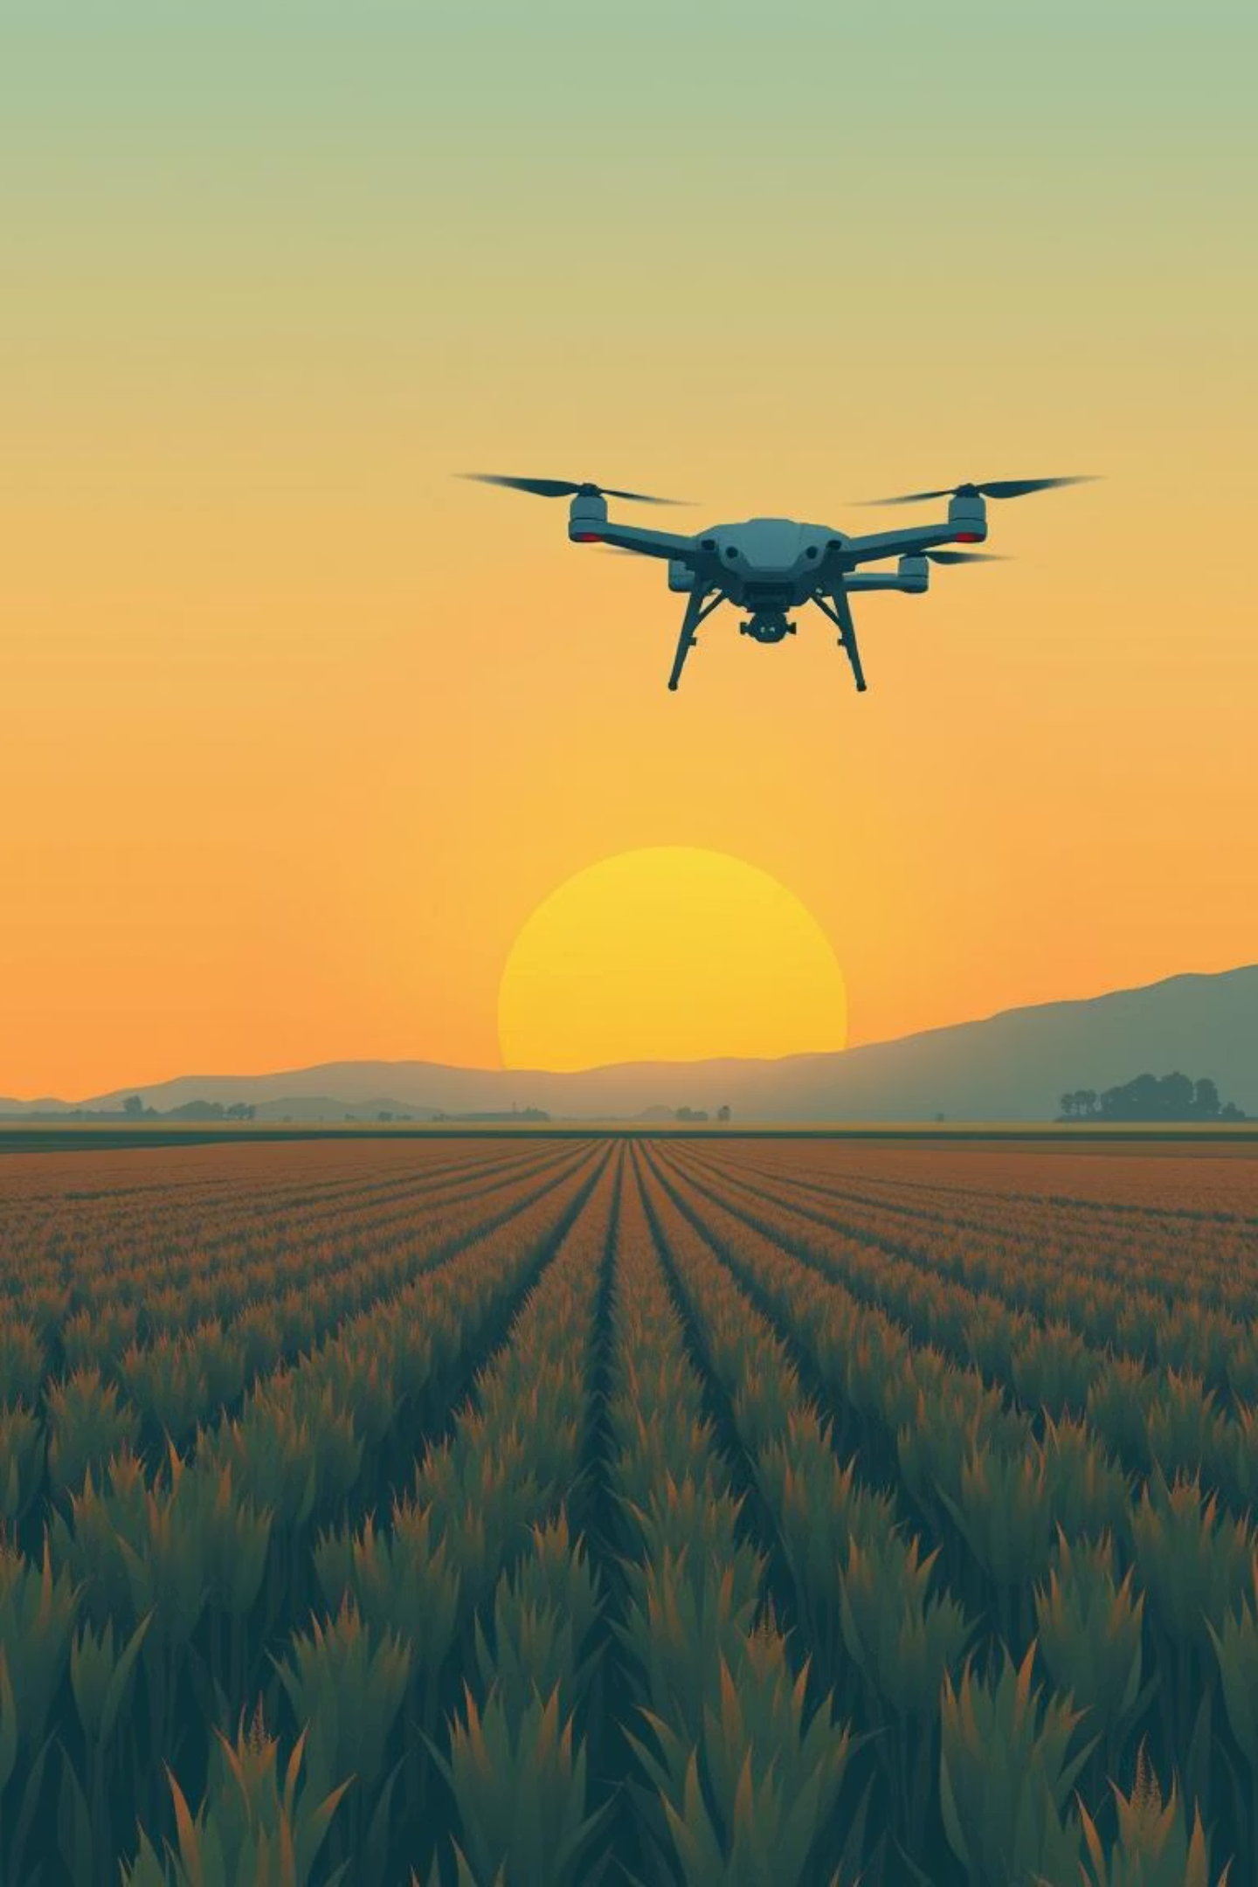
Introduction
One of the most significant developments in modern farming is the use of drones in agriculture. Agricultural drones with cameras, sensors, and GPS. That allows farmers to track plants, monitor crop conditions, and balance the use of fertilizer and water

Slide 3
Background
Drones are used today in many areas like farming, health, and security.
In agriculture, drones help farmers see crop health quickly from the air.
Drones take pictures and collect data that humans cannot get easily by walking
Drone 1 can send a message with the location of sick plants.
Drone 2 can read this message and fly to that point to spray it.
Studies show drones make farming faster, safer, and more accurate

Slide 4
Simulate a drone that calculates NDVI and identifies unhealthy crop areas.
Implement MQTT communication so the detection drone can send coordinates to the response drone.
Simulate a response drone that moves to infected areas and performs targeted pesticide spraying.
Measure performance using
coverage accuracy
response coordination time
and spraying accuracy
Objectives of the project

Slide 5
Methodology
NDVI-based crop health detection.
MQTT communication for real-time data exchange between drones.
Thermal Image Processing: MATLAB scripts simulate and analyze thermal images to identify abnormal temperature zones.
path planning and targeted spraying by the response drone.

Slide 6
Challenges
Developing the system using MATLAB presented several technical challenges :
MATLAB Toolbox Limitations.
Realistic figures for the unhealthy and healthy areas.
Ensuring Full Field Coverage.
Shown results clearly.
Realistic infection detection is right or not.

Slide 7
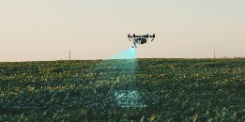
Experimentations & Results
This section describes the experimental setup used to know the proposed of using a drone-to-drone agricultural surveillance system to detect infected areas.

Slide 8
Software :
MATLAB
Basic MATLAB functions for matrix generation, visualization, and numerical simulation
Custom MATLAB implementations for
NDVI generation
Zig-zag scanning Infection detection
Software & Hardware Tools
Hardware :
Laptop or pc
Intel Core i5 and above
8 GB RAM and above
Any operating system can be used

Slide 9
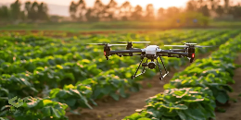
Performance Metrics
Coverage Accuracy (%) = 100%
Percentage of the field scanned by Drone 1
Response Time (seconds) = 0.35 – 0.60 sec per cluster
Time taken by Drone 2 to navigate from its current position to each infected zone.
Spray Accuracy (%) = 62 – 81% by cluster shape
Measures how well the spray cone overlaps the actual infected area.
Battery Usage (%) 86 – 92%
Battery reduction based on flight distance and scanning duration.

Slide 10
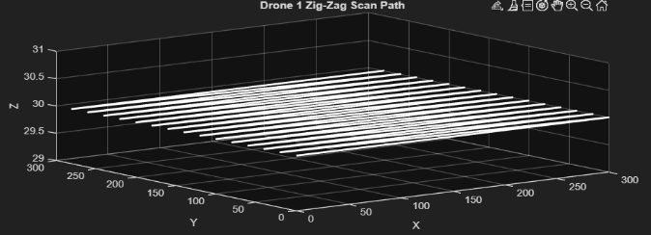
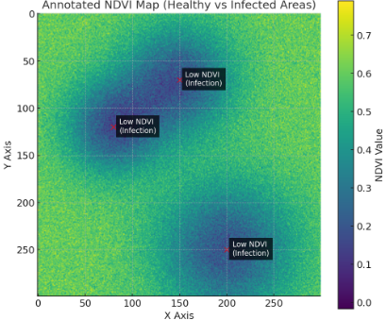
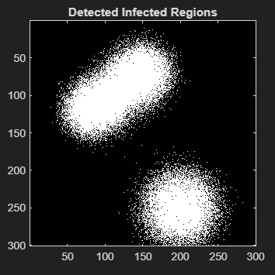
Results

Slide 11
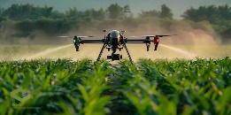
Discussion
The experiments indicate that the two-drone system is able to identify and cure infected areas in the field successfully. Simple threshold Drone 1 is capable of scanning the entire farm and identifying low-NDVI areas

Slide 12

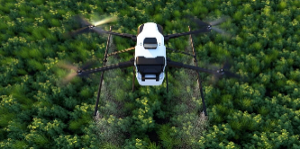

Conclusion
In this project, a simple drone-to-drone collaboration system was simulated to detect and treat infected crop areas. Drone 1 scanned the field and generated an NDVI map, while Drone 2 used path planning to reach infection zones and perform spraying. The results showed that the system could identify unhealthy regions, navigate correctly, and apply treatment with good accuracy

Slide 13
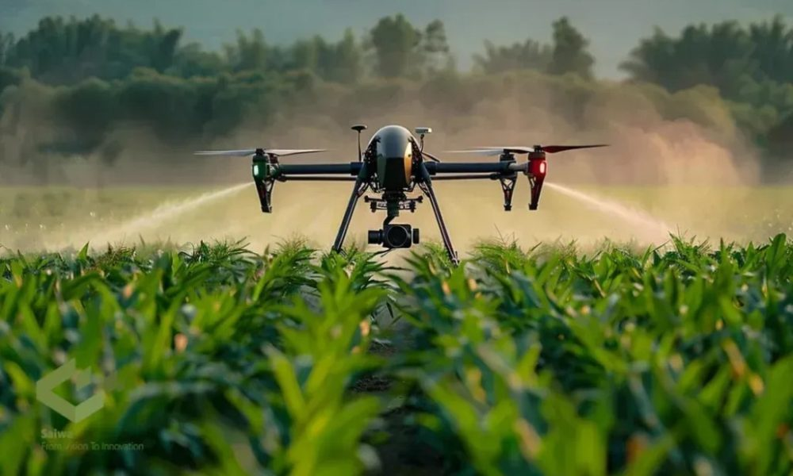
Thanks!

